Slide 1


IT Tickets Handling Process Improvement
Lean Six Sigma Project
Presented By
Chippy Chandra Pillai- 2403836
School of Technology and Innovations
Major in Strategic Project Management

Slide 2


TABLE OF
CONTENTS
PAGE 03
PAGE 09
Project Summary
Resolution Times
PAGE 04
PAGE 10
Project Scope
Root cause Analysis
PAGE 05
PAGE 11
Problem Statement
Implemented Solution
PAGE 06
PAGE 12
Voice Of Customer
reduction in resolution time
PAGE 07
PAGE 13
Control Plan
Baseline Performance
PAGE 08
PAGE 14
Pareto Analysis of Delayed reason
Sustainability Actions
PAGE 15
Benefits and lesson Learned
PAGE 02

Slide 3
Project Summary
Key Findings
32% of resolution time was consumed by redundant information gathering, and 22% of tickets were misrouted.
This project analyzed IT helpdesk ticket handling to identify and resolve inefficiencies. Using the DMAIC methodology, we examined 2,347 tickets over six months, focusing on reducing resolution times and improving consistency.
Achieved Improvements
Average Resolution time reduced by 48%, delayed high/medium priority tickets reduced by 52%, and customer satisfaction increased by 32%.

Slide 4
Project Scope
Defining Boundaries and Objectives
In-Scope Areas
Out-of-Scope Areas
Methodology
The project focuses on improving IT ticket handling processes, including ticket resolution protocols, customer communication, and escalation procedures to enhance efficiency and satisfaction.
Out-of-scope areas include hardware issues, third-party vendor interactions, and network outages, ensuring that the project remains focused on internal ticket management without external complexities.
The DMAIC approach facilitates structured problem-solving, encompassing defining the problem, measuring current performance, analyzing root causes, implementing improvements, and controlling future processes for sustained success.

Slide 5
Problem Statement
Identifying Key Process Inefficiencies
Inefficient Ticket Handling
Project Goals
The current IT ticket handling process is marked by delays, resulting in prolonged resolution times that impact service quality and overall customer satisfaction significantly.
Our project aims to reduce ticket resolution time by 30%, improve First Contact Resolution (FCR) to 80%, and enhance customer satisfaction ratings by 15% within six months.

Slide 6
Voice of Customer
Gathering Insights on Customer Needs
Customer Feedback
Complaint Analysis
Focus Group Insights
Comprehensive customer feedback was gathered through various channels, including surveys and interviews, to understand pain points and expectations regarding the IT ticket handling process.
Analyzing complaints revealed recurring themes, particularly regarding long resolution times and lack of communication, which highlighted critical areas needing improvement for enhancing customer satisfaction.
Focus groups provided qualitative insights on customer experiences, allowing us to identify specific needs and expectations that informed our process improvement initiatives for IT ticket handling.

Slide 7
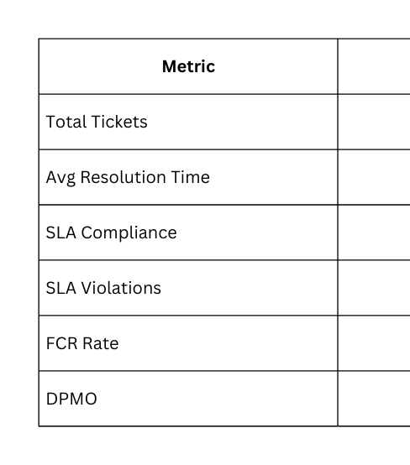
Baseline Performance
Baseline Data
Average resolution time is 9.75 days, with nearly 29% of tickets experiencing delays.

Slide 8
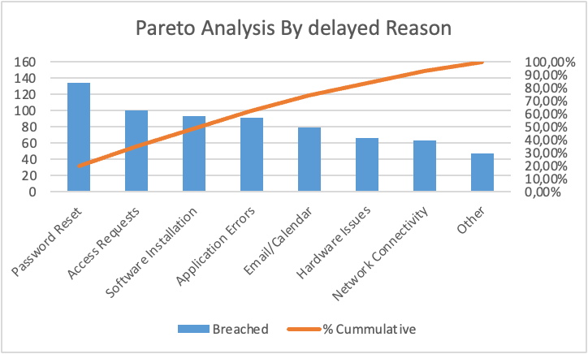
Pareto Analysis
Identifying Key Delay Reasons
Delay Factors
Analyzing delay factors reveals that password resets and access requests are the primary contributors to ticket delays, significantly impacting overall resolution times and customer satisfaction.
Frequency Distribution
A frequency distribution highlights that over 70% of delays stem from just a few key issues, underscoring the importance of targeted interventions to enhance efficiency and service delivery.
Priority Levels
By evaluating priority levels, we find that high-priority tickets experience longer resolution times when compounded by workload variations, indicating a need for better resource allocation and management strategies.

Slide 9
Resolution Times
Analyzing Workload and Prioritization
Priority Impact
Technician Workload
Improvement Opportunities
Higher priority tickets show increased resolution times, with technicians overwhelmed by urgent requests. This pattern highlights the need for streamlined processes to minimize delays in ticket handling.
Workload variations among technicians can cause inconsistencies in resolution times. Addressing these disparities through balanced ticket assignments can significantly enhance overall efficiency and performance.
Analyzing priority and workload variations reveals potential improvements. Implementing targeted training and support can help technicians manage their tasks more effectively, leading to better customer satisfaction.

Slide 10
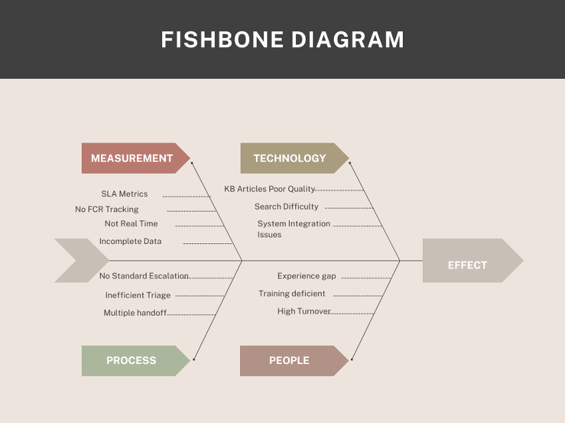
Root Cause Analysis
Understanding Delays in Ticket Handling
People Factors
Process Inefficiencies
Human error and lack of training contribute significantly to delays in ticket resolution. Employees require ongoing education to enhance their skills and knowledge about the ticketing system.
Outdated processes often lead to bottlenecks in ticket handling. Regular review and optimization of these workflows are essential to streamline operations and improve overall efficiency.

Slide 11
Knowledge Base
Implemented Solutions
An enhanced knowledge base was created, providing staff with quick access to information and solutions, which reduced ticket volume and improved resolution times for common issues.
Enhancements for IT Ticket Handling
Training Programs
Comprehensive training programs were implemented for technicians, equipping them with essential skills and knowledge, resulting in increased efficiency and better handling of ticket resolutions.

Slide 12
Reduction in Resolution Time
85%
The pilot project demonstrated an 85% reduction in resolution time, significantly enhancing efficiency and customer satisfaction, and showcasing the effectiveness of the implemented solutions in the IT ticket handling process.

Slide 13
Control Plan
Ensuring Continuous Improvement and Quality
KPI Monitoring
Audit Procedures
Regular monitoring of key performance indicators (KPIs) is essential to ensure sustained improvements. Dashboards will provide real-time insights into IT ticket handling performance and trends.
Scheduled audits will assess the effectiveness of current processes and compliance with updated standard operating procedures (SOPs), ensuring adherence to quality standards and identifying areas for further enhancement.

Slide 14
Continuous Training
Regular training sessions equip team members with the latest best practices, fostering a culture of excellence and ensuring efficient IT ticket handling processes are consistently maintained.
Sustainability Actions
KPI Reviews
Ensuring Long-Term Performance and Improvement
Frequent reviews of key performance indicators allow for proactive adjustments to processes, ensuring sustained compliance with goals and continuous improvement of ticket handling efficiency and customer satisfaction.

Slide 15

Benefits and Lessons
Key Takeaways from the Project
Achieved Benefits
Lessons Learned
The project resulted in significant improvements such as reduced SLA penalties, increased productivity, and enhanced customer satisfaction, ultimately leading to better service quality and improved team morale.
Key success factors included strong executive support and effective pilot testing, while challenges such as change resistance and data quality highlighted areas for further improvement in future projects.

Slide 16

Thank You

